Slide 1
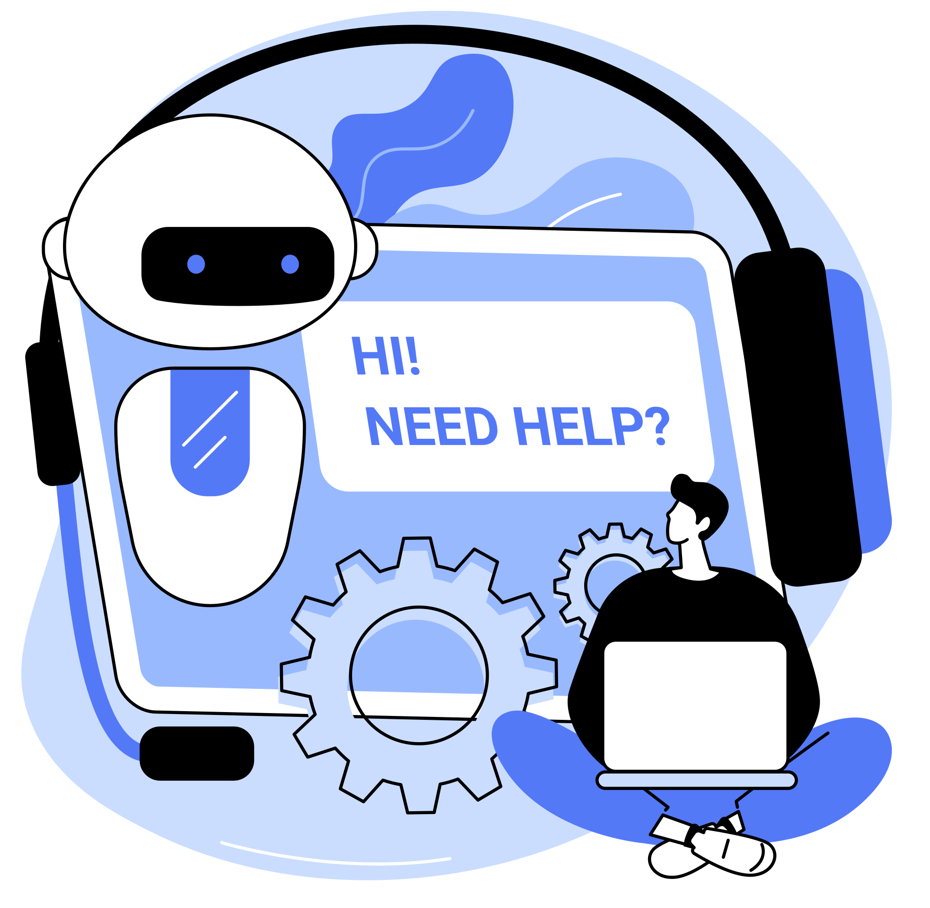

WHAT IS CHATGPT?
Possibilities and applications

Slide 2

Content
How do I subscribe?
What can I do for free with ChatGPD
How does one use ChatGPT?
Good to know!
Problems and solutions!

Slide 3
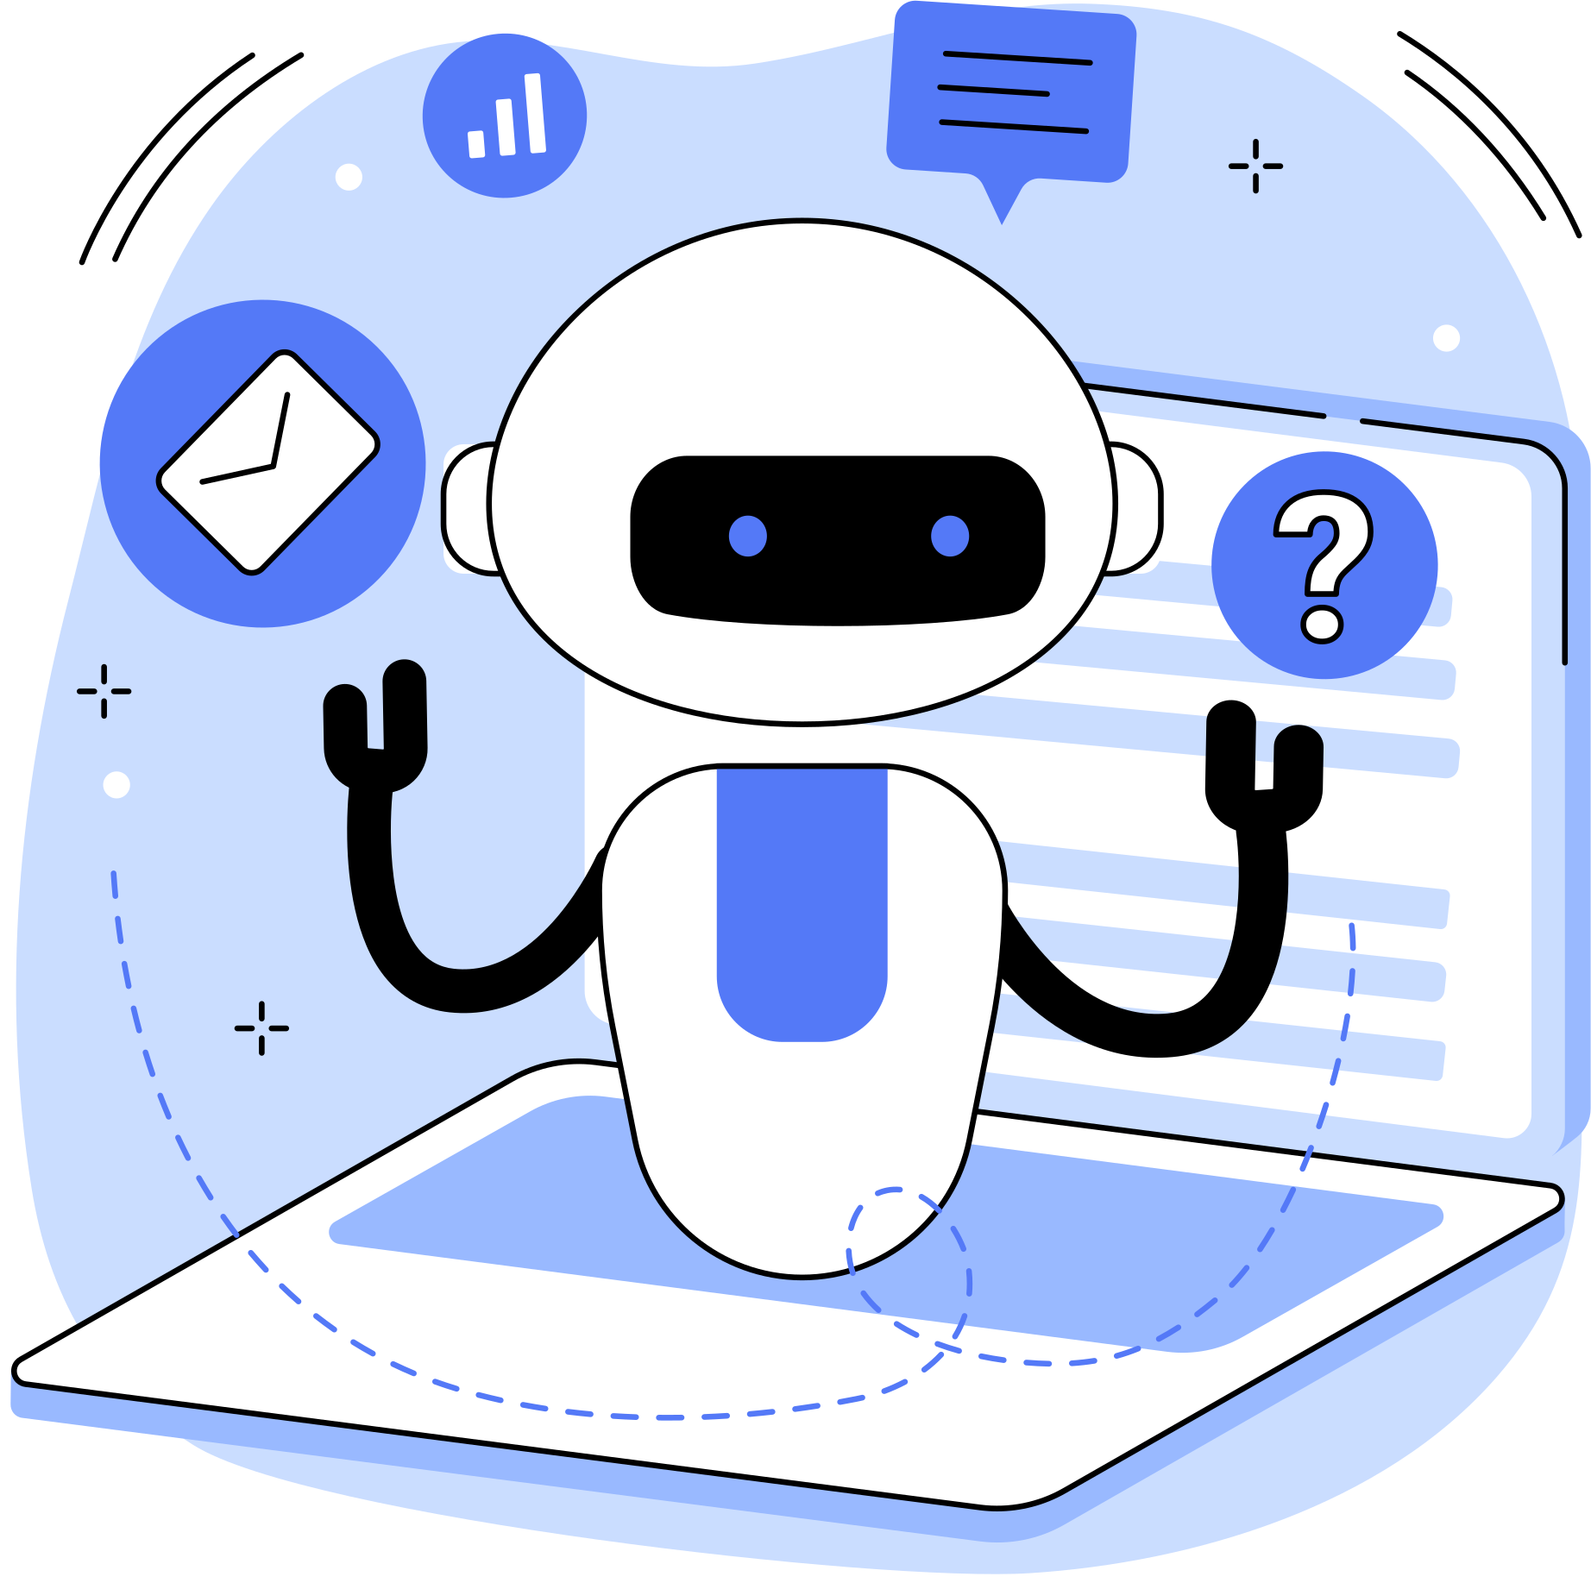
ChatGPT is an AI-supported tool that can help with many tasks, e.g. answering questions, translating, writing texts, learning, programming and much more.
The programme has been trained to understand and respond to human speech. You can think of ChatGPT as a very well-informed digital dialogue partner
You can ask the programme questions or give it tasks which it then solves. It can also be used for brainstorming or idea generation.
What is ChatGPT?

Slide 4
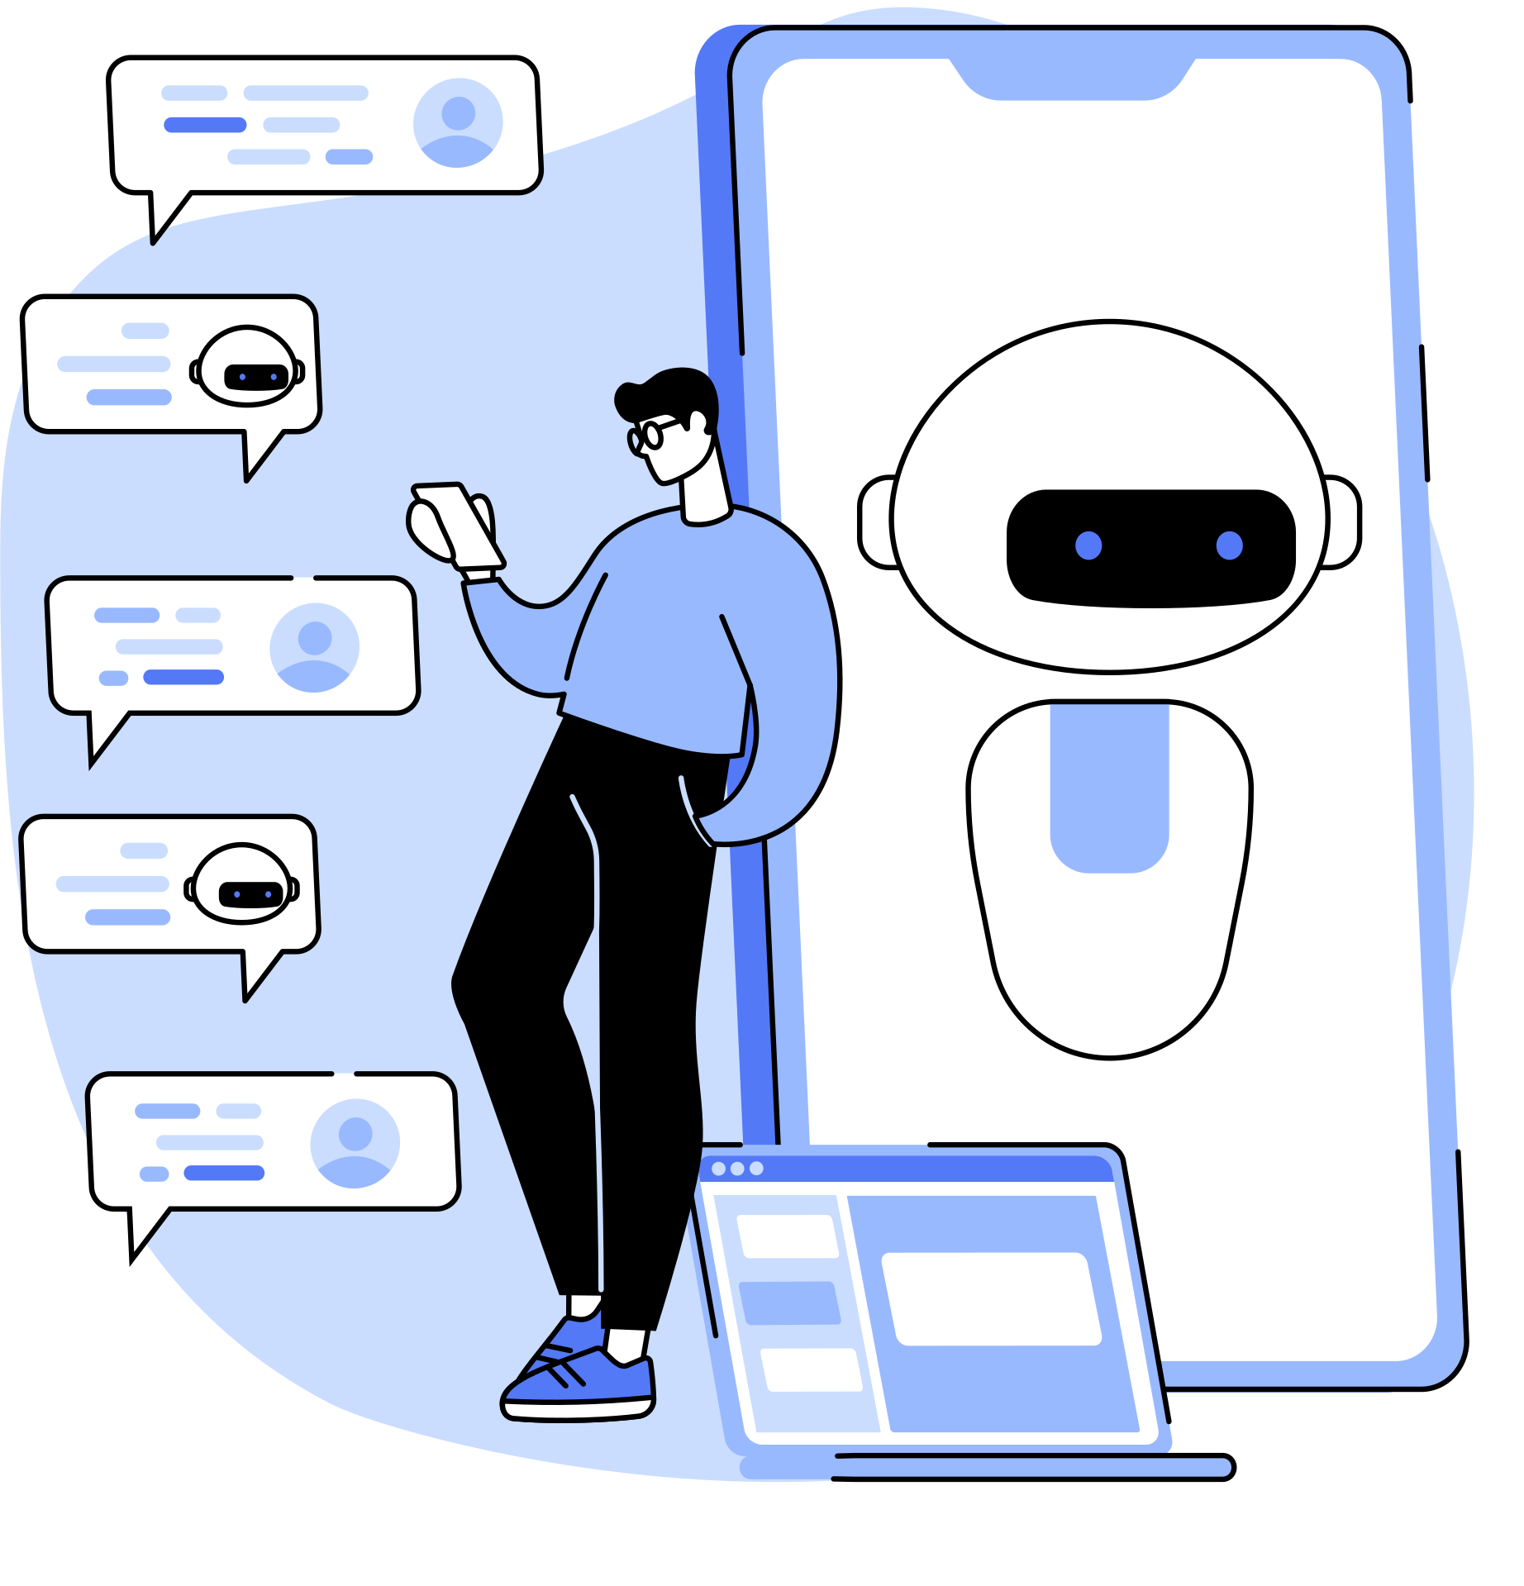
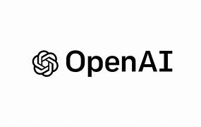
Go to the OpenAI website.
  First, create an account:
  Click on ‘Sign up’.
  Enter your email address or sign in with an existing Google or Microsoft account.
Verification:
  Confirm your email address (you will receive a link in your email inbox).
  You may also need to verify your phone number.
Login:
  After registering, you can log in with your email address and password.
Getting starteD - How do I log in?
https://openai.com

Slide 5

What can I do for free with ChatGPD?
Ask questions
Develop ideas
Create texts
Gaming
Programming
Write e-Mails
Translate
Rewrite texts
Learning&studying
Social media

Slide 6


With the free version of ChatGPT (usually GPT-3.5) you may
Ask questions
Write and rewrite texts
translations
Learning&studying
Translate textes in different languages
Example: “Translate “How do you do?” in spanish
Learning support, explanation of concepts, quizzes, support with homework.
  Example: "Explain the theory of relativity in simple terms."
For example about general knowledge, facts, tips, historical events, science etc.
Example: "What is the difference between a solar and a lunar eclipse?"
Essays, stories, blog posts, poems, speeches, emails and also rewrite them (for example with the instruction “make them simpler or more "formal")
  Example: "Write a friendly email to reschedule a meeting."

Slide 7



Ideas and inspirations
Programming and coding
Social media
Having fun and gaming
Suggestions for projects, creative ideas, brainstorming
Example: "What may I do in Ulm on the weekend?
Questions about programming, fixing code errors, writing scripts.
Example: "Can you write me a Python script for a calculator?"
Design postings, create texts for websites, generate images and more
Example: "Write me a Facebook post on the topic of 'baking biscuits'
Find jokes, riddles and quizzes, games, interesting facts.
Example: “Tell me a funny joke!”

Slide 8
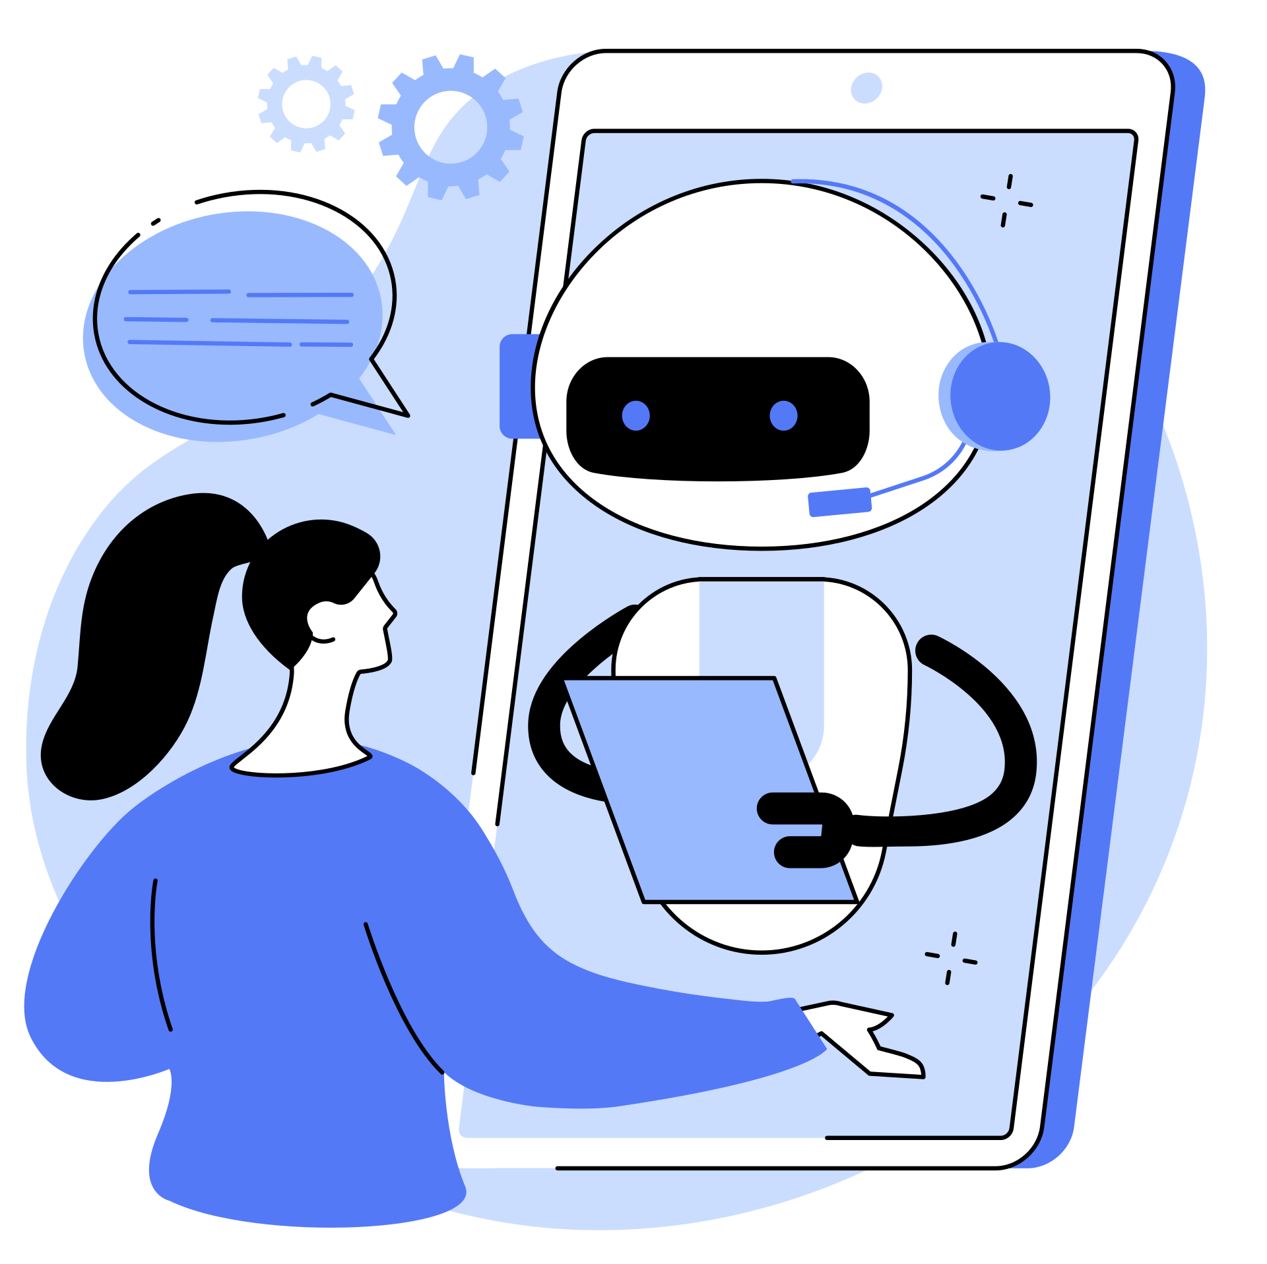
Ask clear questions:
  Formulate your question precisely. Example: Instead of "Help with writing", say "Help me write an invitation for a birthday party."
Follow up with questions:
  If the answer is not clear, you can ask for details or a simpler explanation.
Give examples:
  If you want a specific answer, give an example or explain the context.
Short or long?
  You can ask for short or detailed answers. Example: "Explain it in 2 sentences."
How to use chatGPD properly

Slide 9

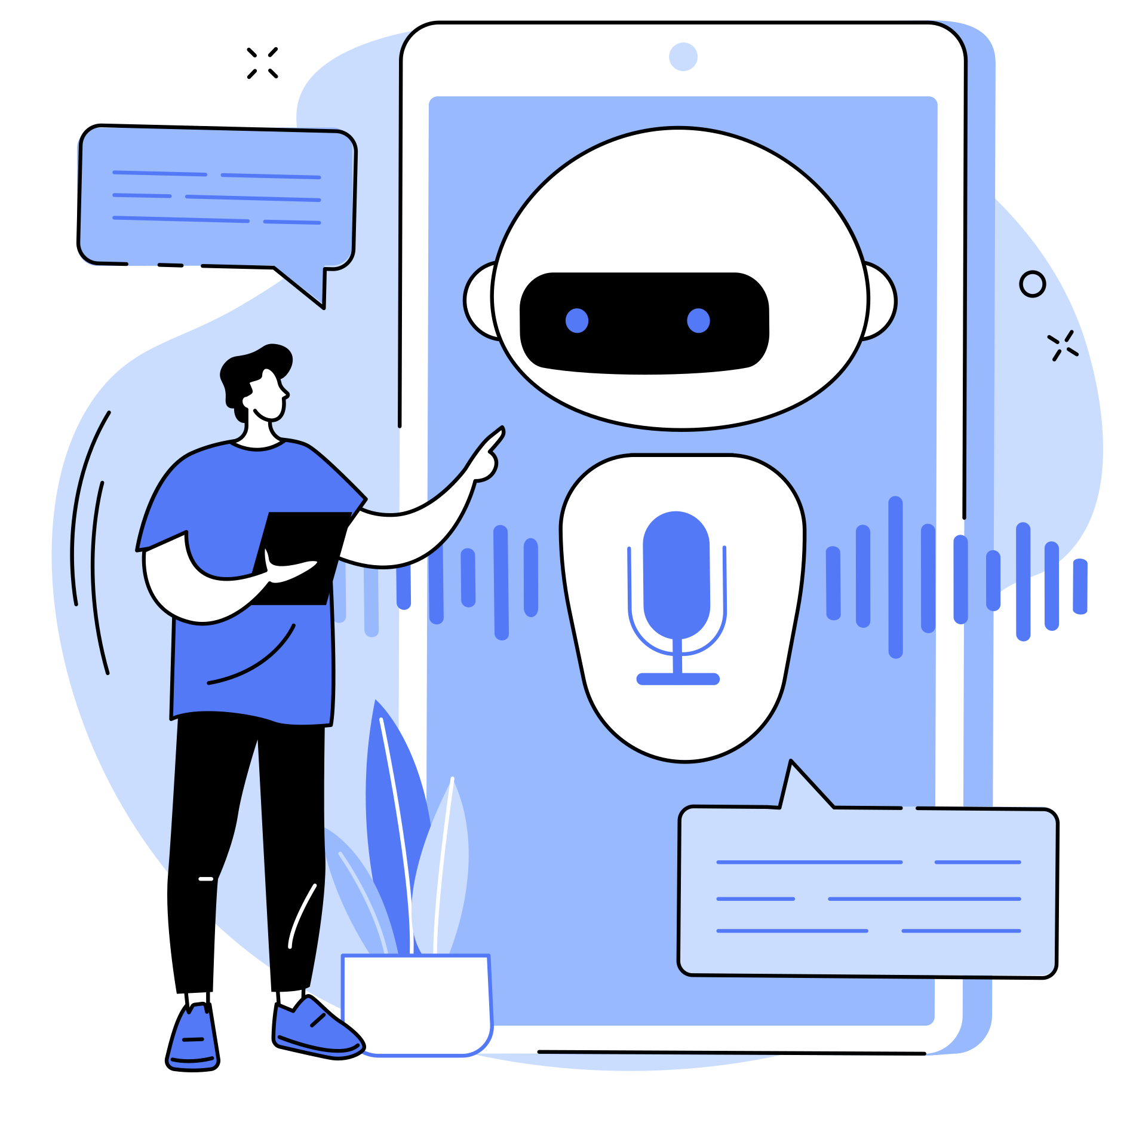
Important notes
Internet connection: You need a stable internet connection.
Data: ChatGPT stores conversations temporarily, so do not share confidential information.
Upgrade: If you need GPT-4 or additional features, you can consider upgrading to the Pro version (for a fee).
Solutions
If the website does not work, check your internet connection or try again later.
Contact support on the OpenAI website if you have problems with your account.
Good to know!

Slide 10

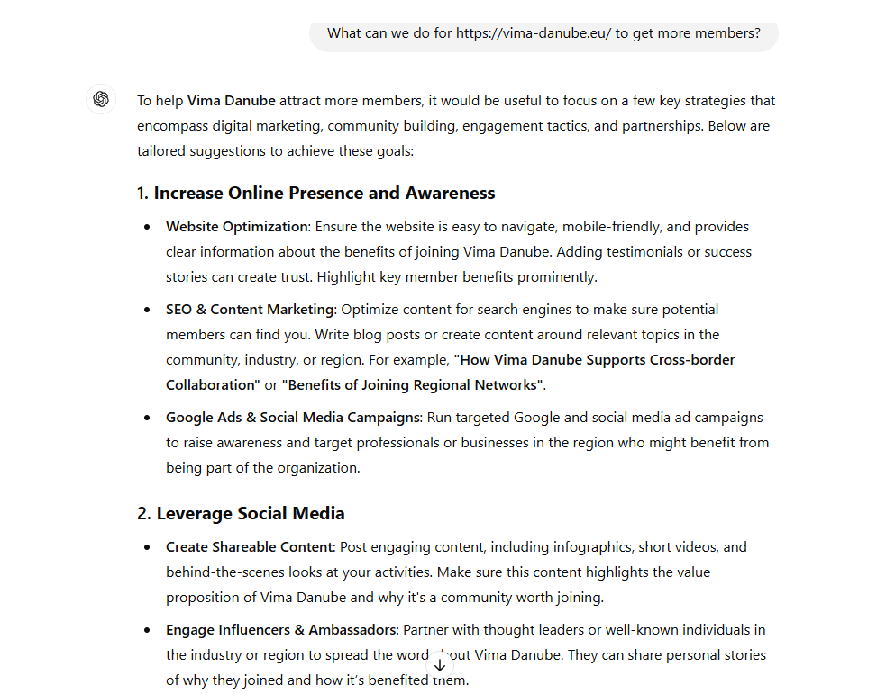
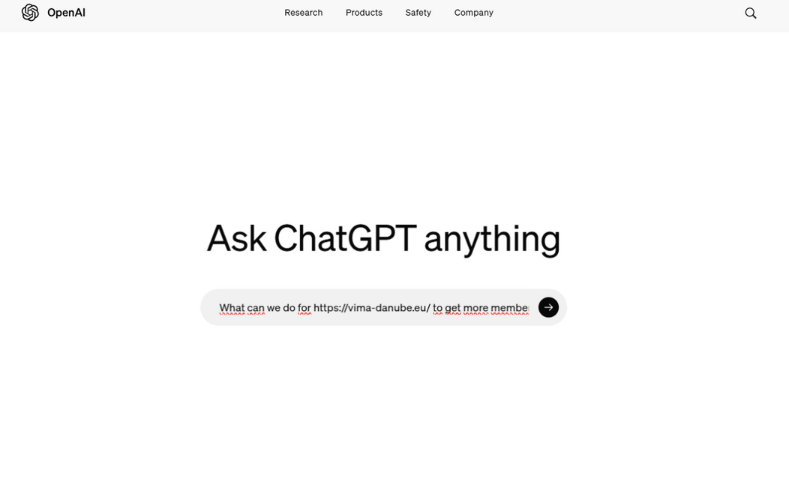
Application examples
Question
  What can we do for https://vima-danube.eu/ to get more members?

Slide 11

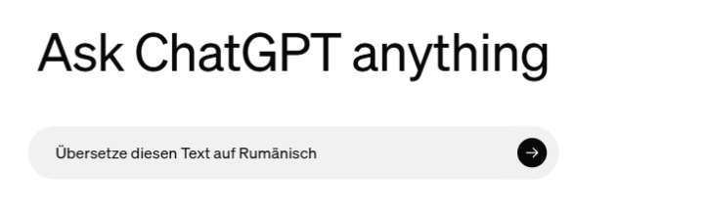
"ViMA danube, accessible at vima-danube.eu, is an open, multifunctional online platform that aims to digitally connect people in the Danube countries and encourage active collaboration. The platform was developed during the pandemic and is being continuously developed. It offers a search-and-bid function and the possibility to form interest groups to socialise and share common interests, even if there is no common language. ViMA danube is available in English and 13 other languages, including German, Romanian, Serbian and others"
“ViMA danube, accesibil la vima-danube.eu, este o platformă online deschisă și multifuncțională, care are ca scop conectarea digitală a persoanelor din țările dunărene și încurajarea colaborării active. Platforma a fost dezvoltată în timpul pandemiei și este continuu îmbunătățită. Oferă o funcție de Căutare-Oferte și posibilitatea de a forma grupuri de interese pentru a stabili contacte și a face schimb de informații despre interese comune, chiar și atunci când nu există o limbă comună. ViMA danube este disponibilă în limba engleză și în alte 13 limbi, inclusiv germană, română, sârbească și altele.”

Slide 12

Another possibility:
Perplexity AI is an AI-based search engine and answer machine that launched in 2022.
It combines elements of traditional search engines like Google with chatbot functionalities similar to ChatGPT.
Main features:
  Processing questions in natural language
  Searching the internet for current information
  Generating answers based on found sources
  Citing and linking the used sources
  Possibility for follow-up questions and conversations
Additional functions:
  File upload and analysis
  Focused search in specific sources
  Creation of structured articles (Perplexity Pages)
  Collections for organizing content

Slide 13
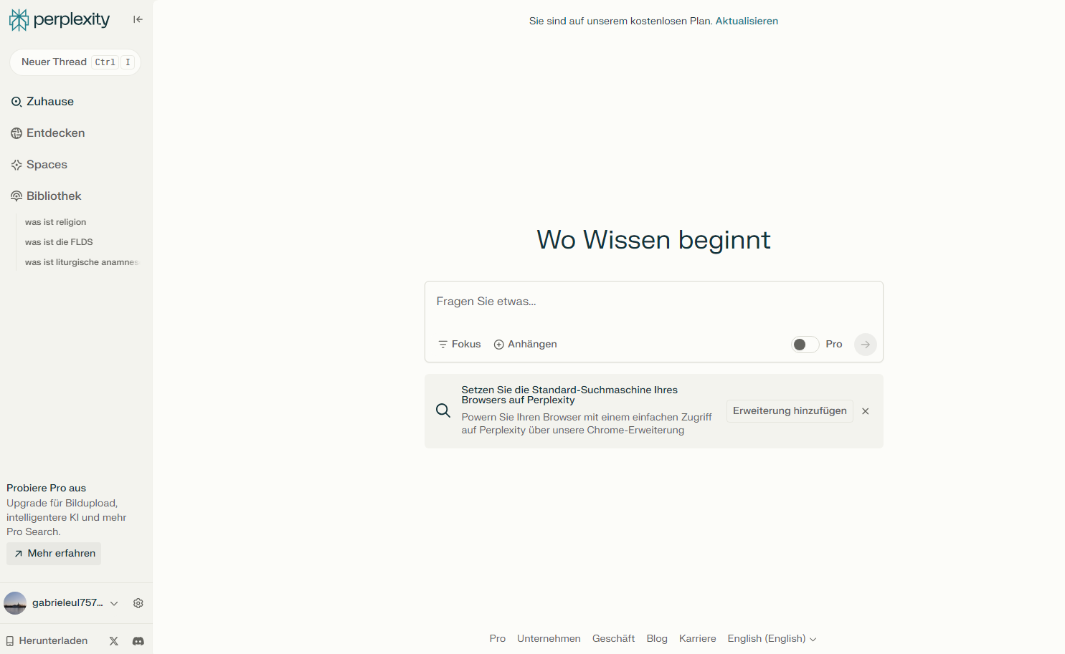

Where knowledge starts

Slide 14
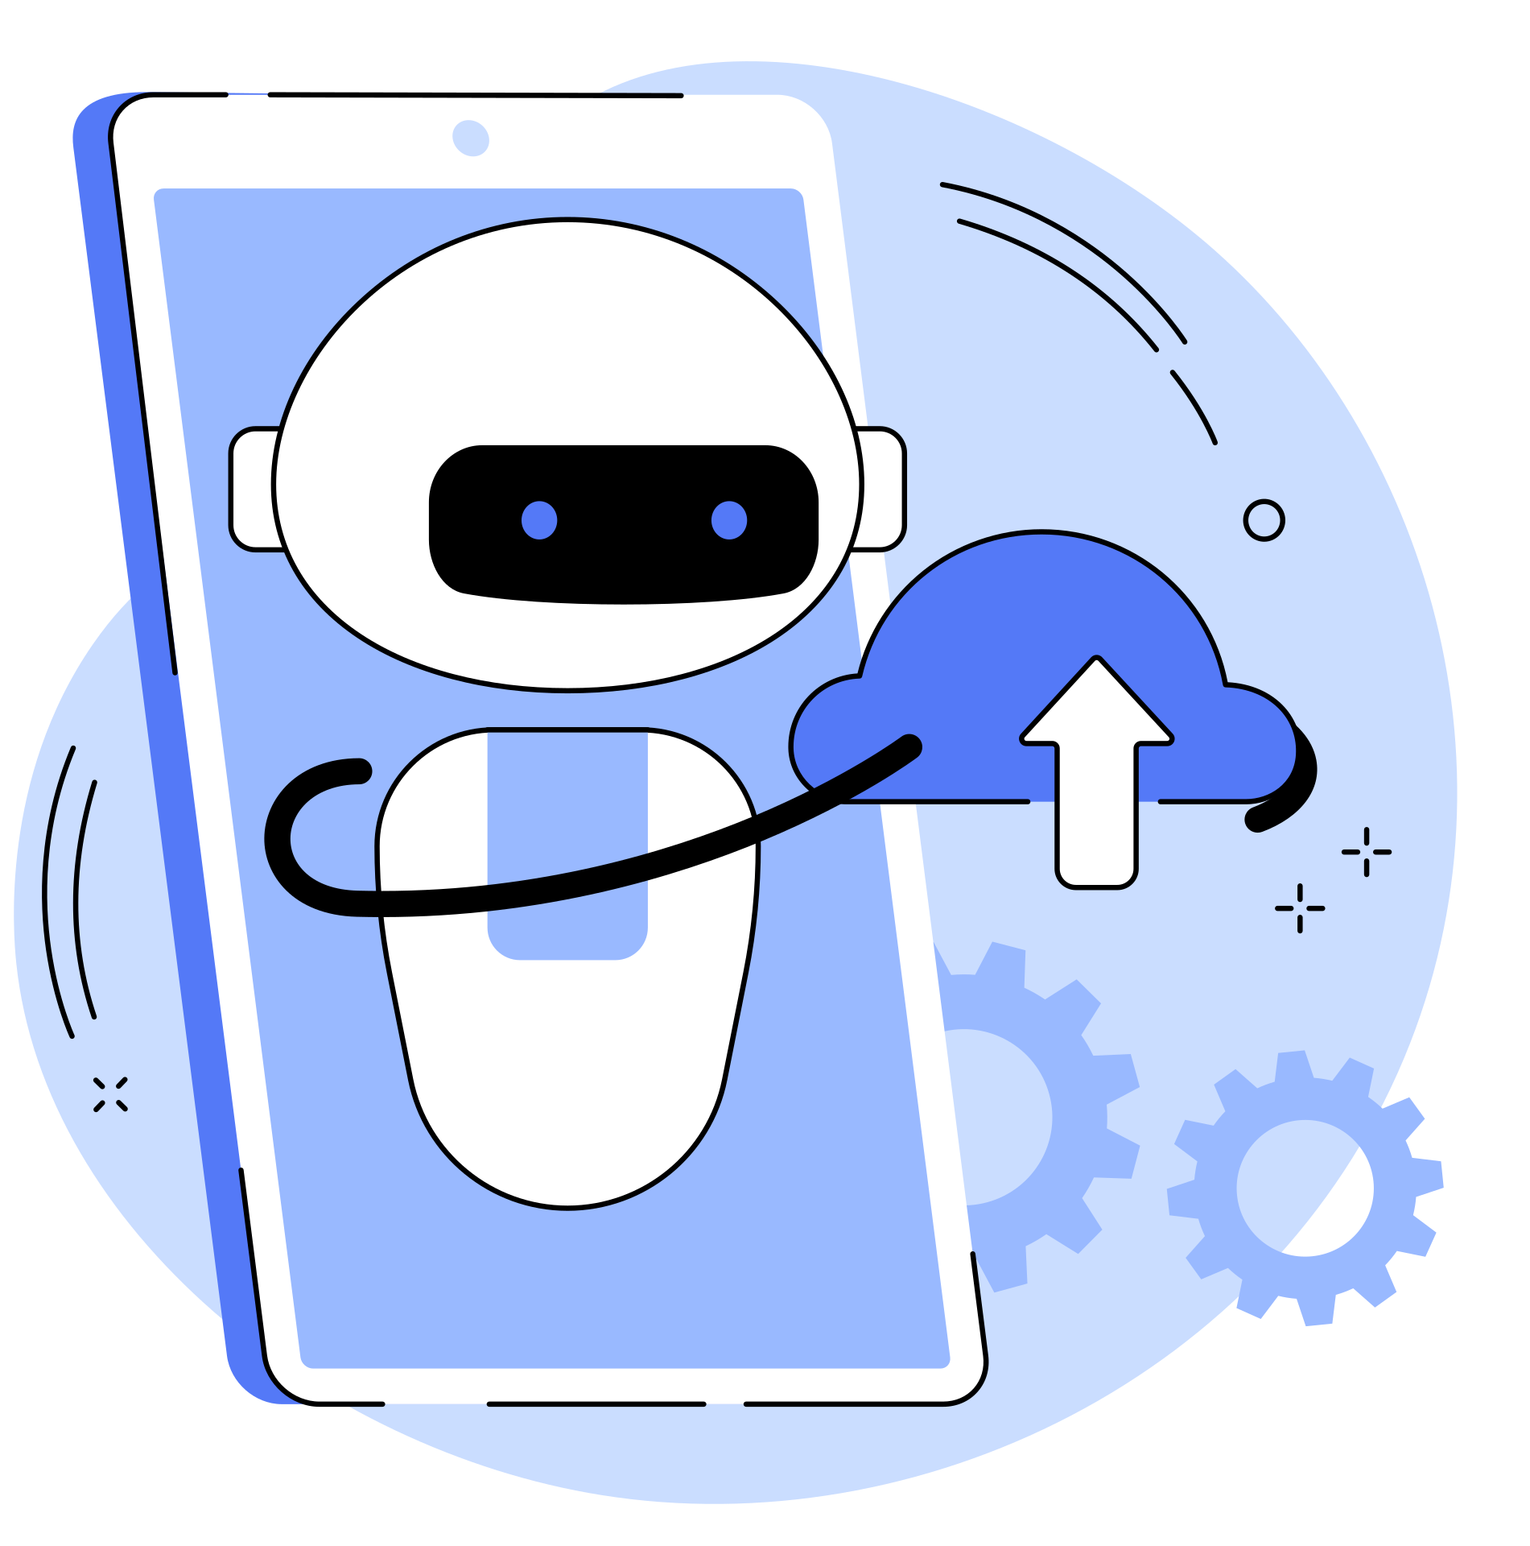
Have fun exploring ChatGPT!

Slide 15


HeyGen is an AI-powered video generator that allows users to create appealing and professional videos in a short time.
The platform uses AI to simplify the video creation process. You don't need any special technical skills or expensive equipment to use it.
Features:
- Creating avatars
- Translating videos
- Video production

Slide 16

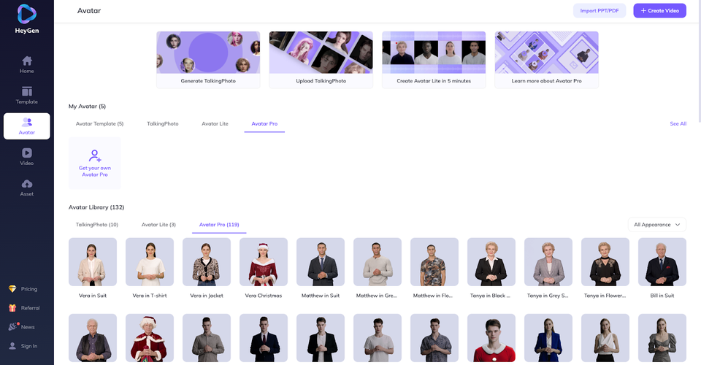
Details on HeyGen
- Virtual speakers: Choose from over 100 different computer characters to speak for you.
- The app can speak in more than 40 languages and has over 300 different voices.
- Fast videos: Just enter text and get a professional video in minutes.
- Templates: There are many templates for marketing, training or social media.
- Translation: Videos can be easily translated into other languages.
Advantages
HeyGen is super easy to use. Even if you have never made videos before, you can easily create professional videos.
The app is perfect for companies and organisations that want to produce appealing content quickly.

Slide 17
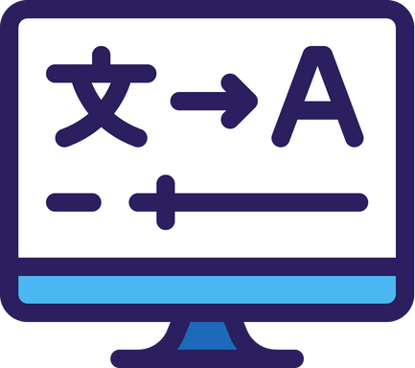
Strengths
  The synthetic voice in the target language sounds very similar to the original
  The voice translation for HeyGen is impressively accurate
  The intonation is reproduced true to the original
  Lip movements are adapted so that they match the translated language and are barely recognisable as artificial
Weaknesses
  The generated voice still sounds slightly robotic or mechanical
  Background noise and music can affect the translation quality
  The system seems to have problems completing translations on time when the workload is high

Slide 18

Let's try it out!

