Slide 1
Democracy as Self-Government – Democratic Innovations by and with Citizens
Prof. Dr. Brigitte Geißel
Goethe-University, Frankfurt
Research Unit Democratic Innovations
Institute for virtual and face-to-face learning in the area of adult education Ulm (ILEU e.V.)
Project: Fit4Democracy,
Tuesday, 15 July 2025, at 6:00 p.m.

Slide 2
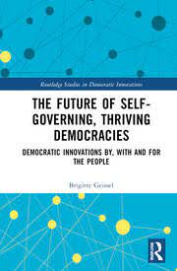
Intro
Representative democracy is
in crisis….
How to proceed?
What can we do to help shaping
the future of democracy?
New ideas and visions
“A map of the world that does not include
utopia is not worth even glancing at……
Progress is the realization of utopia”
Oscar Wilde
Presentation is based on my
recent book:

Slide 3
Outline
1. Democracy in Crisis
2. Task of Political/Social Science:
Paternalistic advices OR
Support for citizens to govern themselves?
3. Democracy as self-governing
3.1 Definition
3.2 Normative and empirical arguments
3.3 Experiences
4. Outlook

Slide 4
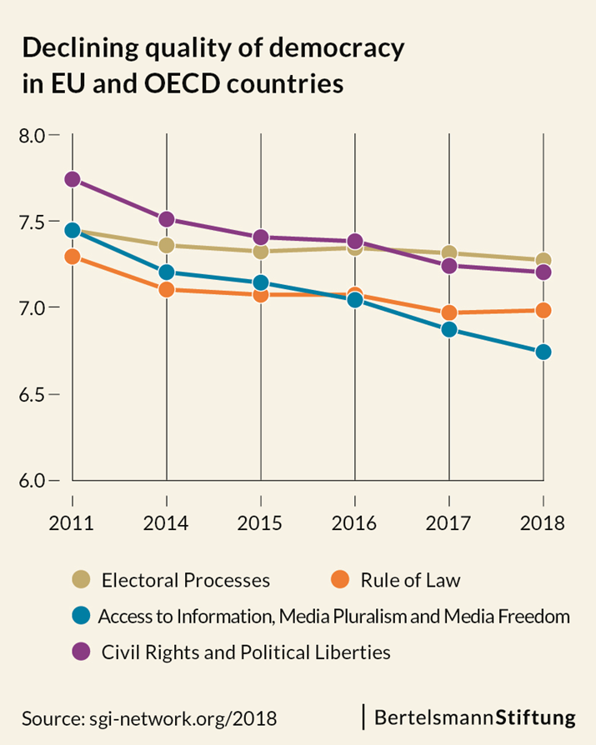
1. Democracy in Crisis

Slide 5
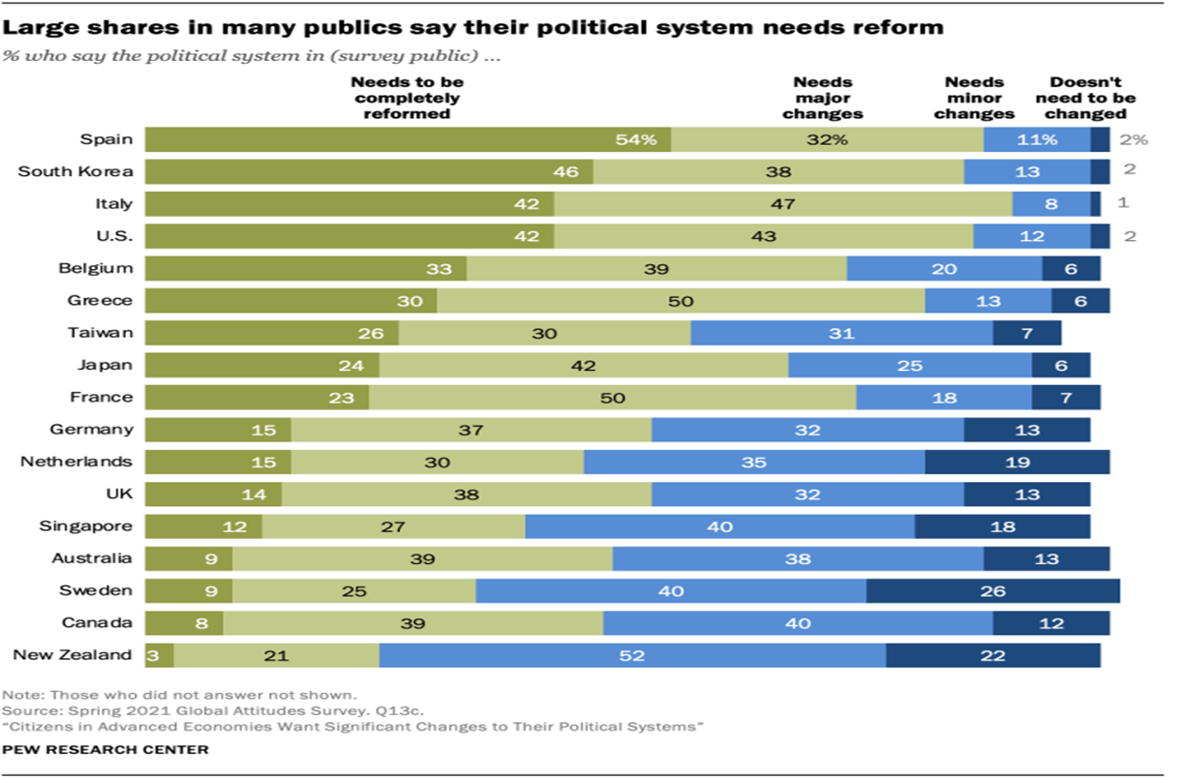
1. Democracy in Crisis

Slide 6
2. Task of Political/Social Science
Paternalistic advices for how to improve democracy are proliferating. They
- advocate the author’s favorite model or practice as
supposedly better option;
- insinuate that these ‘favorites’ are the supposedly best
alternative for each and every community;
- do not take into account that citizens and communities have
different preferences, resources and needs.
Examples:

Slide 7
2. Task of Political Science – against paternalistic models
Paternalistic models as potential ‘redeemers’
“Open democracy” with lottocratic alternatives and mass leadership via “representing and being represented in turn” (Landemore 2020);
“Deliberative systems” with “nodes” and “multiple forms of communication” (Mansbridge at al. 2012);
“Democracy without shortcuts” with a “long, participatory road” (Lafont 2020);
“Creating impetus, resonances, clamour and turbulence”, to “act in ‘swarm’ or ‘crowd’ mobilizations”, to “create resonance” and to “diffuse power” (Tormey 2015) .
But…
some citizens and communities might not want a “deliberative system”, “lottocratic alternatives” or “clamour and turbulence”.

Slide 8
2. Task of Political Science – against paternalistic practices
Paternalistic practices as potential ‘redeemers’
social movements and protest groups (e.g. Tormey 2015; Della Porta 2013),
mini-publics and other deliberative practices (e.g. Curato et al. 2021);
referendums (Altman 2019);
participatory budgeting (Sintomer et al. 2016);
liquid democracy/vote delegation (Valsangiacomo 2021);
randomly selected parliaments or “multi-body sortition” (Reybrouck 2016; Hennig 2017; Gastil & Wright 2019);
‘everyday activities’ as for example the playful protest of the ‘Knitting Nannas Against Gas’ (Hendrics et al.2020);
experts, technocrats and ‘the informed’ (Brennan 2016).
But…
some citizens and communities might not want mini-publics, referendums or ‘multi-body sortition’……

Slide 9
2. Task of Political Science – against a paternalistic approach
Support citizens to govern themselves (Mansbridge)
- No one-size-fits-all suggestion;
- no predetermined model or practice as supposedly
best way of governing every and all communities;
- take into account what citizens and communities
want and need.

Slide 10
3. Democracy as self-governing
Instead of advertising certain models of democracy or specific democratic practices:
Let us go back the roots of the meaning of democracy as self-governing by, with and for the people – to rephrase Lincoln’s famous saying.
Advancing Mansbridge’s (2014b) notion that political science is about helping citizens to govern themselves,
I claim that political/social science is tasked to support citizens and communities in their search for the best way of self-governing.

Slide 11
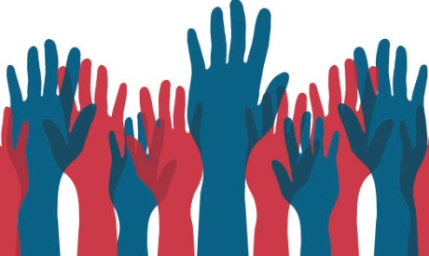
.3.1 Democracy as self-governing –
Definition
n?
Self-governing means that citizens and communities deliberate and decide about the kind of democracy they want to live in (tenets, practice, procedures)
and adapt it continuously.
Self-governing starts with participatory
constitution-building and is an ongoing process
(no set of institutions set up for ‘eternity’).
Self-governing gives political authorship
and ownership back to the citizens.
Citizens and communities are the
creators, authors and owners of their democracy.

Slide 12
3.1 Democracy as self-governing
- explanatory examples
A community with responsive, reliable, and honest politicians might be perfectly fine with representative democracy;
citizens trust their representatives and do not consider any participatory practices beyond elections as necessary.
Another community might be heterogeneous, deeply divided, and conflict-prone with a history of corrupt politicians;
it might prefer to combine several participatory practices in addition to elections in order to achieve inclusive deliberation and involvement, e.g. mini-publics and direct democratic practices.
A third community with a longstanding history of participatory practices might get rid of elections;
implements a combination of a randomly selected chamber of parliament, multi-issue referendums, and vote delegating (liquid democracy).

Slide 13
3.2 Normative arguments
Democracy is not a board game or a card game, where players just have to learn the rules prescribed by game designers.
Although some politicians and scholars seem to see democracy that way, it is not.
Neither politicians nor scholars ’know’, what democracy is, and they cannot judge whether citizens’ ideas are ‘right’ or ‘wrong’.
Democracy does not mean that people learn and live according to rules prescribed by ‘expert democracy designers’.
Citizens are the Sovereign;
this rule should also apply to the design of democracy itself, which should meet the refined preferences of their sovereign
(exceptions: human rights and civil liberties).
Might be especially important in polarized societies, where politicians can not come to terms (e.g. Belgium, G1000)?

Slide 14
3.2 Empirical arguments, examples
Democracies are
more stable when they are aligned with the democratic process preferences of their citizens (Almond & Verba 1963; 1989; Lipset 1959; Quaranta 2018; Claassen 2020; Elkins et al. 2009);
more inclusive “when the people are the authors of their own rights” (Eisenstadt et al.2017, 143);
more beneficial for ordinary people, e.g. Samuels (2017, 4): participatory, inclusive processes of constitution building “tended to result in constitutional drafts which provided rights to those groups which had not up to then gained political protection or recognition”.
Also: democratic revitalization.
When citizens get the possibility to have a say, they gain feelings of efficacy and democratic authorship, which increases resilience to populism, polarization and extremism.
Populist narratives constructing the story of ‘corrupt elite versus the people’ will fall on unfertile ground.

Slide 15
3.3 Experiences with participatory constitution building
Citizens elect the members of the assembly that drafts the constitution, for example in Chile.
A randomly selected citizen assembly recommends constitutional amendments, which were decided via referendum, e.g. in Ireland.
In Iceland an intricate procedure tried to ensure a crowdsourced constitution (see next slide).
South Africa had invited a broad public debate with e.g. a radio talk show and multiple channels for citizens to supply suggestions for the new constitution.
But: All these processes can only be described as symbolic or of limited impact (Saati 2016; Hudson 2021);
a far cry from the approach of self-governing I propose.

Slide 16
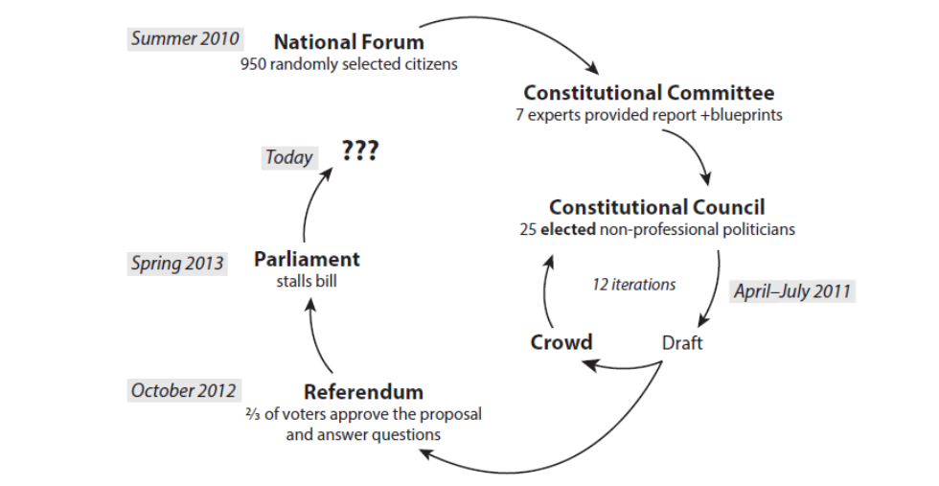
Icelandic experiment of participatory constitution-making (2010-2013)
Source: Landemore, 2020, p. 157

Slide 17
4. Outlook
Shifting the perspective from representative democracy to self-governing democracy,
entails
to help developing novel practices and procedures for self-governing
starting with participatory constitution-building and continuing with an ongoing process of self-governing

Slide 18
3. Outlook
If you want to learn more on the topic:
Also available open access

Slide 20
The following slides will not be presented (just in case of respective questions)

Slide 21
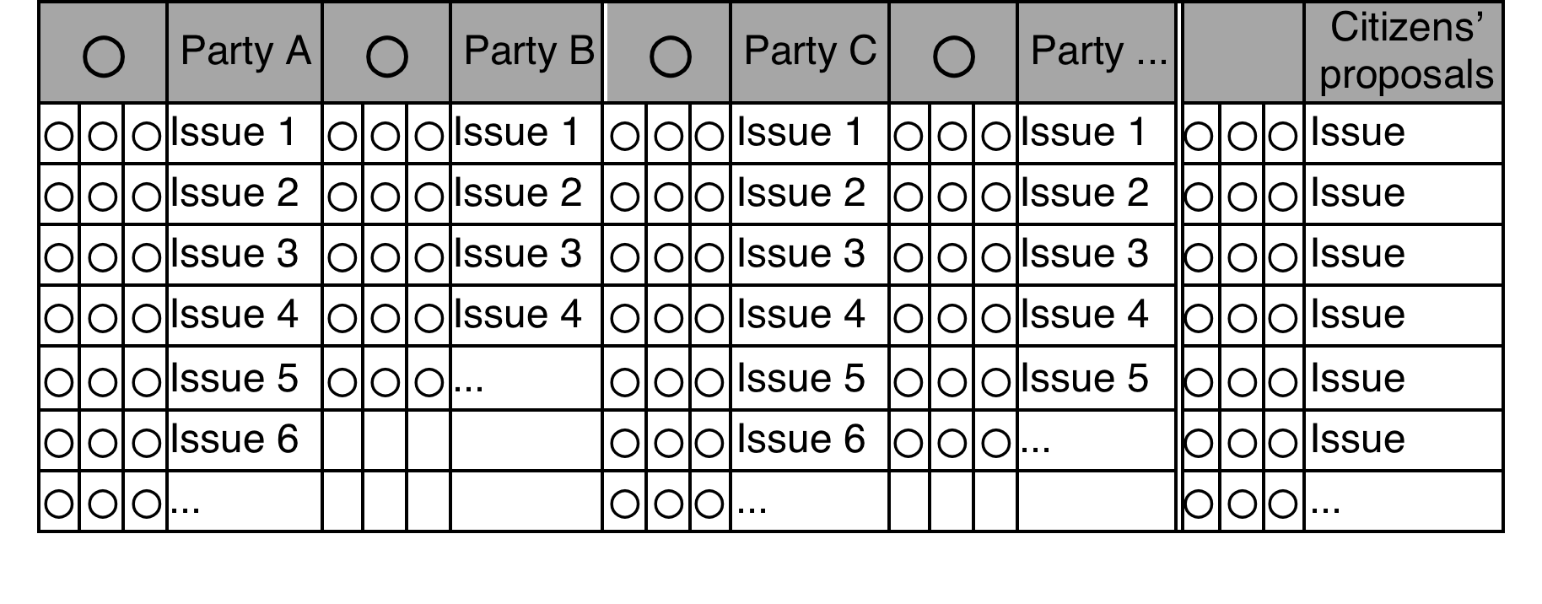
Multi-Issue Referendum
(Rinne 2021)
Praxis-Test in Filderstadt, 1000 participants

Slide 22
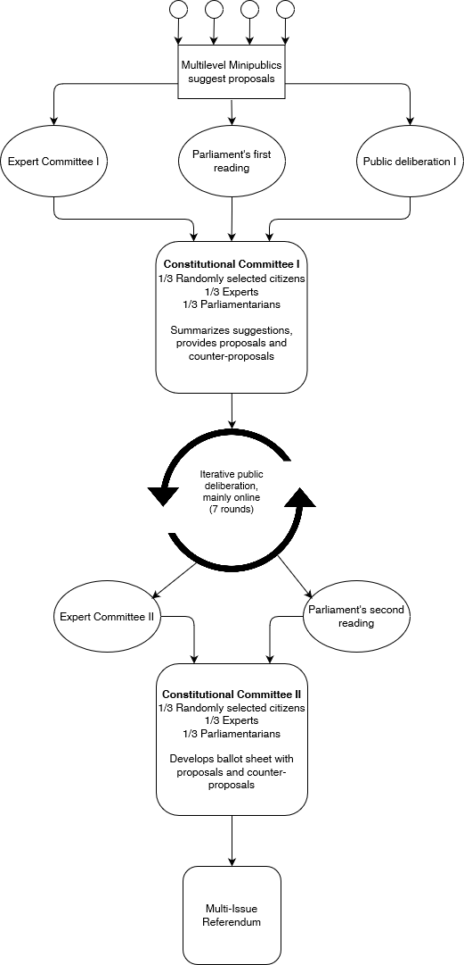
Example for novel procedure

Slide 23
Constitutional Assembly drafts first proposals
First public deliberation,
supported by experts
Multi-level mini-public suggests second proposals
Elected and selected chambers suggest third proposals
Preparation of Deliberation Day
Second public deliberation
Multi-level mini-public develops fifth and final proposals
Multi-Issue Referendum
Community decides to become a Thriving Democracy
Elected and selected chambers suggest fourth proposals
Deliberation Day

Slide 24
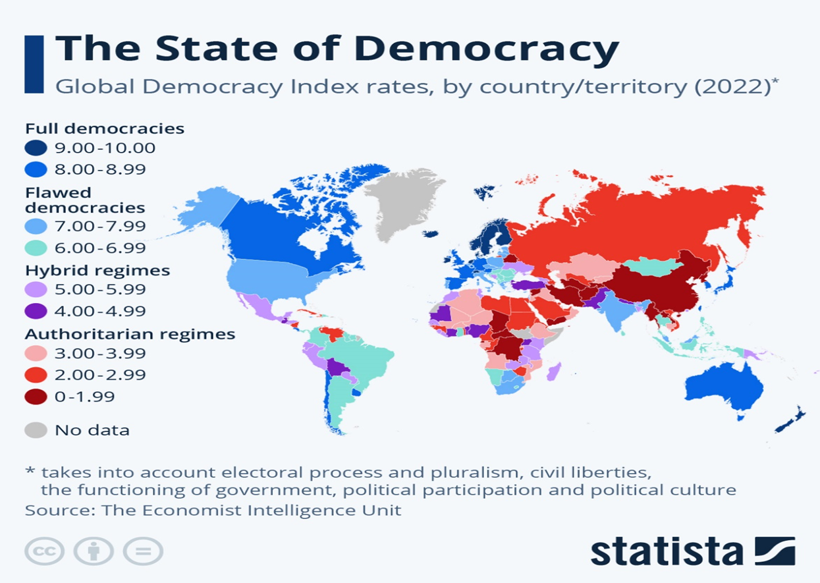
1. Democracy in Crisis

