Slide 1




15 September, 2026
EU Funding Session –
A new landscape (MFF 2028-2034)
Online training session

Slide 2
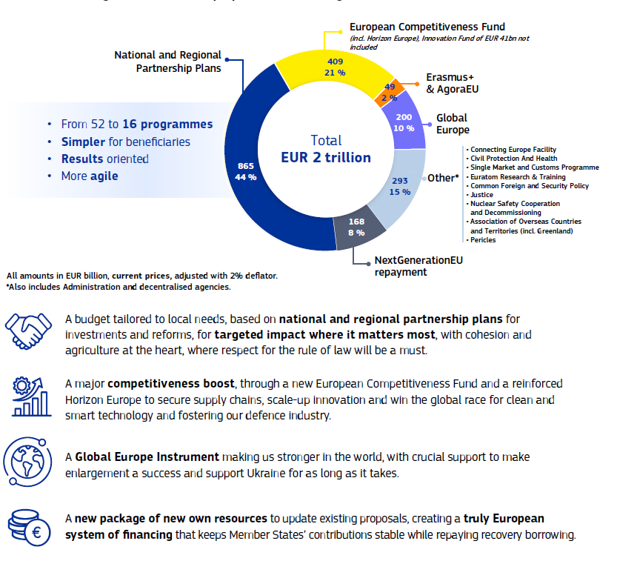
SIZE & STRUCTURE OF THE EU BUDGET
European Commission Website, Europe´s Budget, 2026
Notes:
https://op.europa.eu/en/publication-detail/-/publication/10993d4a-d7d1-11f0-8da2-01aa75ed71a1/language-en
Reduction in EU Programmes
Grouping Funding into larger thematic envelopes
Fewer but larger funding entry points
Stronger need to align activities with EU political priorities (democracy, resilience, competitiveness, security, external action)

Slide 3


National and Regional Partnership Plans (NRPPs)
European Commission Website, Europe´s Budget, 2026

Slide 4
National and Regional Partnership Plans (NRPPs)
NRPPs are core shared‑management delivery mechanism in 2028–2034, integrating investments and reforms in a single plan agreed by Member States and the Commission.
NRPP objectives include:
Economic, social and territorial cohesion
Stronger policy coherence and EU‑priority alignment
Long‑term, Place‑based programming with flexibility
NRPPs rely on the partnership principle, involving public, economic and social partners. Civil society organisations are partners in design, implementation, monitoring and evaluation.
Notes:
https://commission.europa.eu/topics/budget/eu-budget-2028-2034-explained/investing-people-member-states-and-regions_en
European Social Fund 2028-2034

Slide 5
National and Regional Partnership Plans
June-July
2026
End 2026
Mid 2027
~2028
2028-2034
Political & legal set-up
Triogue negotiations
Member States draft NRPPs
EC Assessment & Adoption
Implementation & Fund allocation
Council adopted ist Partial General Approach on the NRPP regulation, establishing the mandate for negotiation.
EU Parliament began processing amendments to the NRPP framework. A solidified opintion is expected by end of 2026.
High-level budget agreement before the end of the year.
EU Member States are expected to begin submitting their draft NRPPs to the EC.
The European Commission reviews NRPPs.
Negotiations between Commission and Member States are formally approved.
Funds are allocated through national/regional instruments. Calls, tenders, and partnership agreements are launched.
Notes:
Opinion

Slide 6

AgoraEU
European Commission Website, Europe´s Budget, 2026

Slide 7
AgoraEU
AgoraEU is the main EU programme dedicated to civil society, culture, media and democratic values for 2028–2034.
It merges two existing programmes:
  Creative Europe (Culture & MEDIA), and
  Citizens, Equality, Rights and Values (CERV).
Total budget: €7.6 bn (2025 prices) / €8.6 bn (current prices)
Around 0.43 % of the total EU budget allocated to culture, media and civil society
Objective: simplification, flexibility and stronger impact for culture, media, democracy and EU values
Consultation of the European Economic and Social Committee (EESC) and the European Committee of the Regions (CoR) is mandatory for this proposal. In their published opinion, further recommendations included explicitly recognising civil society advocacy role.
16 July, 2025
Publication of AgoraEU Proposal
12 May, 2026
Council agrees a partial negotiating mandate on Agora EU
2026-2027
Ongoing negotiations between Council and Parliament
Notes:
https://www.europarl.europa.eu/RegData/etudes/BRIE/2026/782660/EPRS_BRI%282026%29782660_EN.pdf
https://www.eesc.europa.eu/en/our-work/opinions-information-reports/opinions/agoraeu-and-justice-programmes
AgoraEU: Council agrees partial mandate on new programme to support culture, media and democratic values - Consilium

Slide 8

Global Europe
European Commission Website, Europe´s Budget, 2026

Slide 9
(NDICI) Global Europe
Global Europe is the single instrument for EU external action in 2028–2034.
Funding will focus on:
Democracy support (Participation and local governance)
Human rights and rule of law
Gender equality and inclusion
3 Pillars:
Geographic pillar (€60.39 bn): cooperation with partner countries & regions
Thematic pillar (€6.36 bn): Human rights & democracy (€1.36 bn): Civil society organisations (€1.36 bn); Peace, stability & global challenges (€3.64 bn).
Rapid‑response pillar (€3.18 bn): crisis prevention & response
*Flexibility cushion (€9.53 bn) for emerging priorities
Objective: eradicate poverty, promote sustainable development, democracy, human rights, peace and stability
*IPA III outside NDICI – preparing beneficiary countries for accession, also with assistance of Reform and Growth Facility
16 July, 2025
Publication Global Europe Proposal
16 June, 2026
Council adopts a partial negotiating mandate on Global Europe
2026-2027
Ongoing negotiations between Council and Parliament
Notes:
https://international-partnerships.ec.europa.eu/funding-and-technical-assistance/funding-instruments/global-europe-neighbourhood-development-and-international-cooperation-instrument_en
https://www.europarl.europa.eu/RegData/etudes/BRIE/2025/774702/EPRS_BRI(2025)774702_EN.pdf
2028-2034 MFF: Regulation establishing Global Europe

Slide 10

EuroAccess Website, 2026

Slide 11
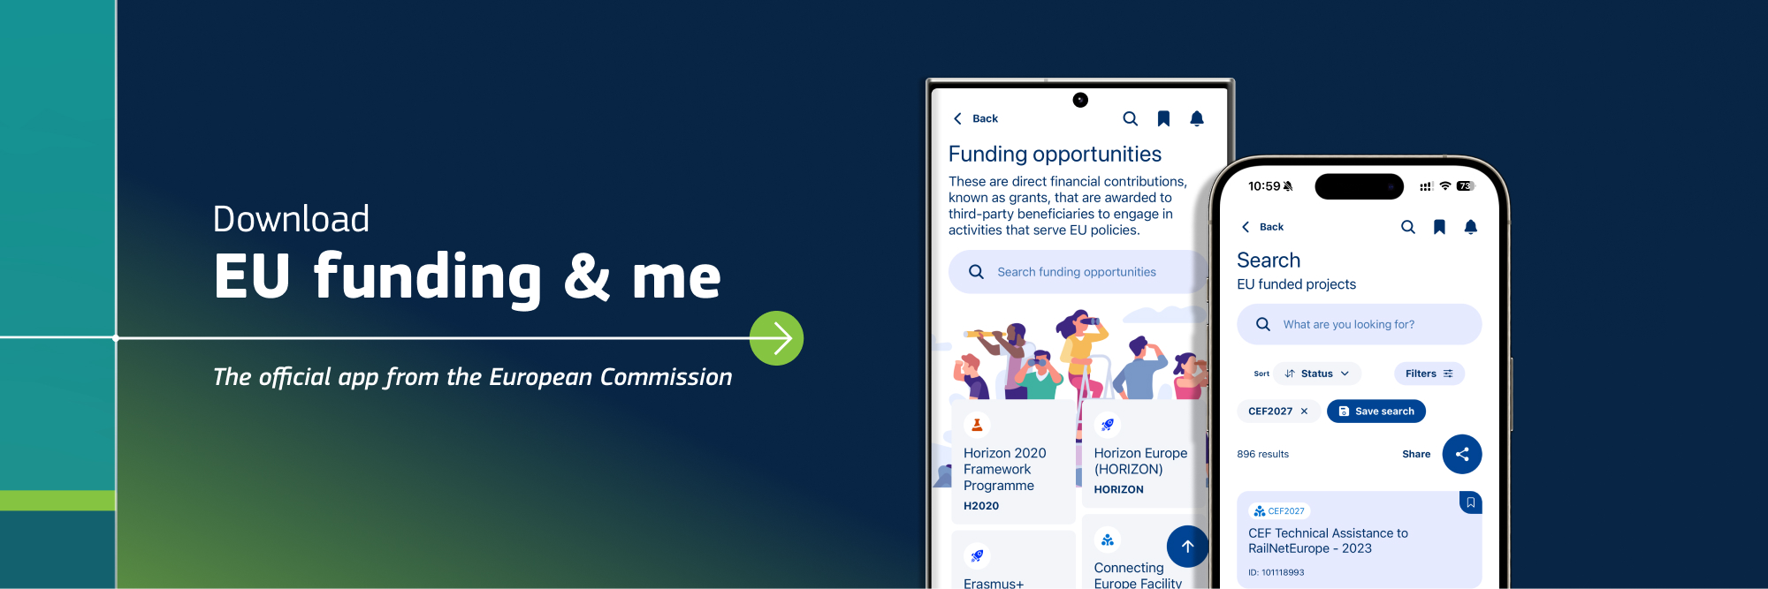

European Commission Website, EU Funding & me, 2026
Notes:
https://interoperable-europe.ec.europa.eu/collection/portal-support/news/eu-funding-me-mobile-application?gad_source=1&gad_campaignid=23753956265&gclid=CjwKCAjw-8vPBhBbEiwAoA39WpW6Nb3SvA1GiqSHuFGC4kEr0VVsVbqBgYqLd2y57fqOExak6hL28xoCOycQAvD_BwE

Slide 12
Discussion
What opportunities/risks do you see for civil society organisations in the transition from the old framework to the new one?

