Slide 1
EU Strategy for the Danube Region:
A brief guide for civil society and local actors
Online Training on EU Funding Opportunities | 15 September 2026
Claudia Singer-Smith, EU Danube Strategy – Priority Area 10

Slide 2
What is the EU Strategy for the Danube Region?

Slide 3
14
countries

Slide 4
12
priorities

Slide 5
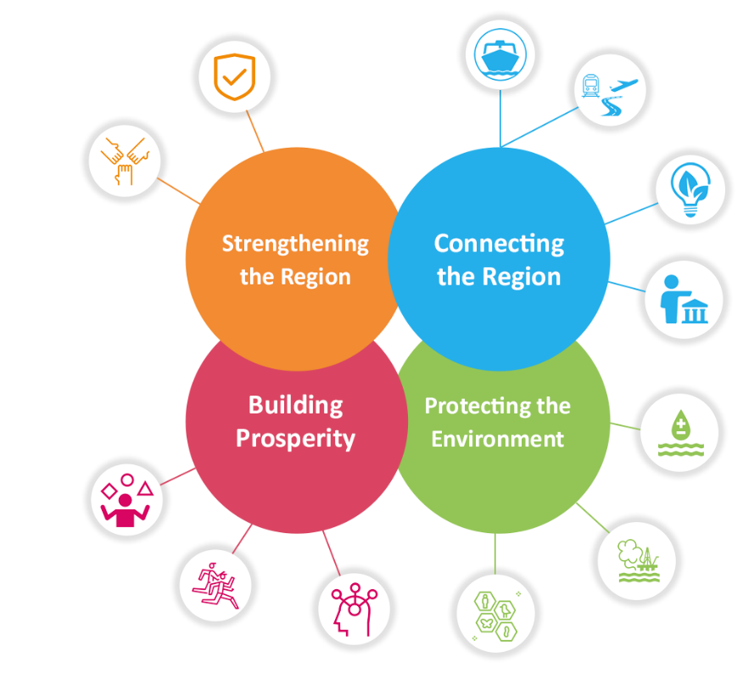
Waterway Mobility
Security
Rail-Road-Air Mobility
Institutional Capacity & Cooperation
Sustainable Energy
Culture & Tourism
Water Quality
People & Skills
Environmental Risks
Competitiveness
Research
Biodiversity
danube-region.eu/about-eusdr/eusdr-governance-priority-areas/

Slide 6









How does the EU Danube Strategy work?
From Strategy to Implementation…
Pilot projects
Policy & Stakeholder networks/ Funding networks
Policy analyses
Policy advocacy
Strategic funding plans/Strategic policy plans
Mutual Learning Events
Etc.

Slide 7
How does the EU Danube Strategy work?
From Project(s) to Policy…
Policy Recommendations
Transferable project results & pilot initiatives
Identifying knowledge gaps
Assessing advocacy needs and opportunities
Identifying & mobilising relevant stakeholders for policy implementation
Etc.

Slide 8


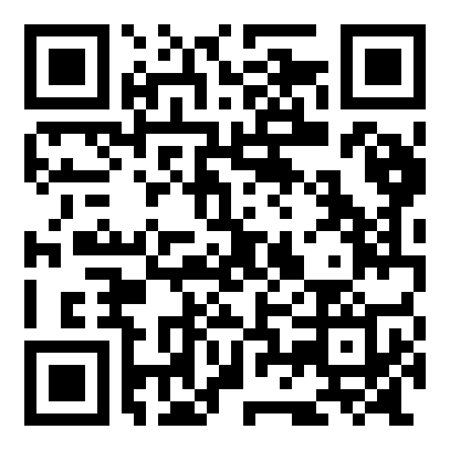
Priority Area 10 ‚Institutional Capacity & Cooperation‘
ACTION 1: To improve institutional capacities in order to provide high-quality public services
ACTION 3 & 4: review bottlenecks relating to the low absorption rate of EU funds & better coordination of funding
ACTION 2: administrative cooperation of communities living in border regions
ACTION 5: innovative funding solutions for local actors and civil society
ACTION 7: involvement of civil society and local actors
ACTION 6: mutual trust between state and non-state actors
ACTION 8: capacities of cities and municipalities to facilitate local and regional development
capacitycooperation.danube-region.eu/

Slide 9
Strengthening Civil Society Cooperation in
Priority Area 10 ‚Institutional Capacity and Cooperation‘
ACTION 1: To improve institutional capacities in order to provide high-quality public services
ACTION 2: administrative cooperation of communities living in border regions
ACTION 8: capacities of cities and municipalities to facilitate local and regional development
ACTION 5: innovative funding solutions for local actors and civil society
ACTION 7: involvement of civil society and local actors

Slide 10
Strengthening Civil Society Cooperation in
Priority Area 10 ‚Institutional Capacity and Cooperation‘
Networking
Strategic Project Development
Danube Local Actors Platform
Funding information
Capitalisation
Consultation & Strategy Development
capacitycooperation.danube-region.eu/danube-local-actors-platform/

Slide 11
Want to get in touch?
Contact & Info Priority Area 10 “Institutional Capacity and Cooperation”
Website | capacitycorporation.danube-region.eu
Team Contacts | https://capacitycooperation.danube-region.eu/contact/priority-area-coordinators-10/
LinkedIn PA10 | https://www.linkedin.com/company/eusdr-pa10-institutional-capacity-and-cooperation/
EuroAccess | https://www.euro-access.eu/en

